Slide 1

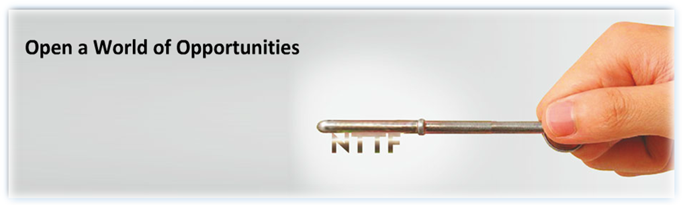
Welcome to:
Nettur Technical Training Foundation
“We Build Skills that Shape our Nation”

Slide 2
MSD PROJECT 2018-2021
LOPIFIT
PRESENTED BY
HARSHITHA G NEC 15 17 521
PEETAR R K NEC 15 17 544
PRABHAKARAN U NEC 15 17 545
SATHISH P NEC 15 17 549
VISHAL G NEC 15 17 558
B GEETH PAVAN KUMAR NEC 15 16 030

Slide 3

CONTENTS
ABSTRACT.
INTRODUCTION.
PROJECT IN BRIEF.
MECHANICAL DESIGN.
MODULAR BLOCK DIAGRAM.
MODULAR DESCRIPTION.
PROTEUS.
APPLICATION.
OVERALL BILL OF MATERIALS.
CONCLUSION.

Slide 4
ABSTRACT
This project work modifies a treadmill to better fit the requirements of users. LOPIFIT is designed for those humans who love to run outside. Treadmill equipped on bicycle frame and formulates a big innovation named ‘LOPIFIT’.
This bicycle has electronic parts and runs perfectly on human momentum. As the rider walks on the treadmill, the belt butts up against the rear wheel propelling the bike forward.
Treadmill bicycle is designed for runners as the ideal treadmill device, this device combines the best exercise running and cycling to deliver a low-impact, high-performance workout outdoors. We believe it is the ideal device for healthy runners. It delivers an exercise experience that is closer to running than anything else avaluable today

Slide 5
INTRODUCTION
The Lopifit (Treadmill bicycle) is completely a new way of commuting completely designed for runners. Typically using a treadmill basically is similar to running, hiking or walking.
Think about the last time you were riding a bike over some kind of obstacles such as train tracks, potholes, speed bumps. Possibilities are you stood up on the pedals to improve your balance when crossing the obstacle. Basically, the Lopifit will provide the rider a well-balanced position the entire time. It is a combination of amalgamation of DC motor with different components upgrading your walking speed to a much higher pace.

Slide 6
PROJECT IN BRIEF
AIM
The main aim of this project is to help the people to commute in a cost-effective mode of transportation without the use of non-renewable energy sources and eco-friendly to nature.
OBJECTIVES
The LOPIFIT (treadmill bicycle) is a totally new way of moving with the electric assist it takes less effort to walk then “a walk in the park”. Nowadays, increase in use of fuel has resulted in increase of pollution and degradation of natural resources.
PROJECT TARGET
To implement the project to help the people to commute in a cost-effective mode of transportation without the use of renewable energy sources.

Slide 7
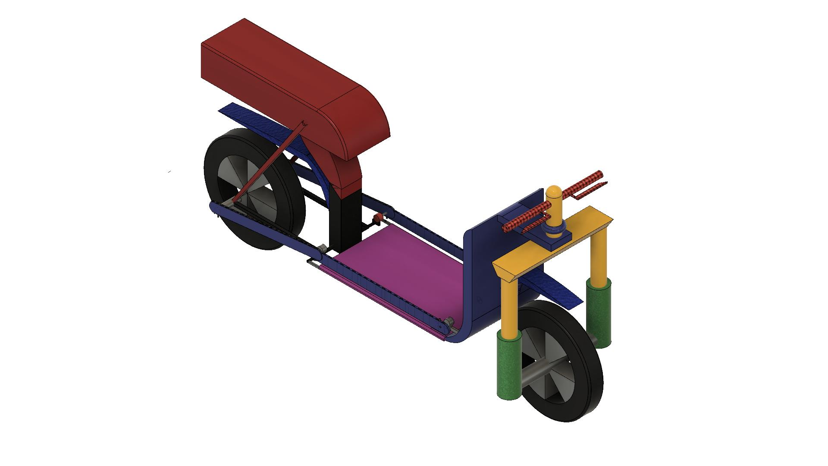
OVERALL ISOMETRIC VIEW

Slide 8
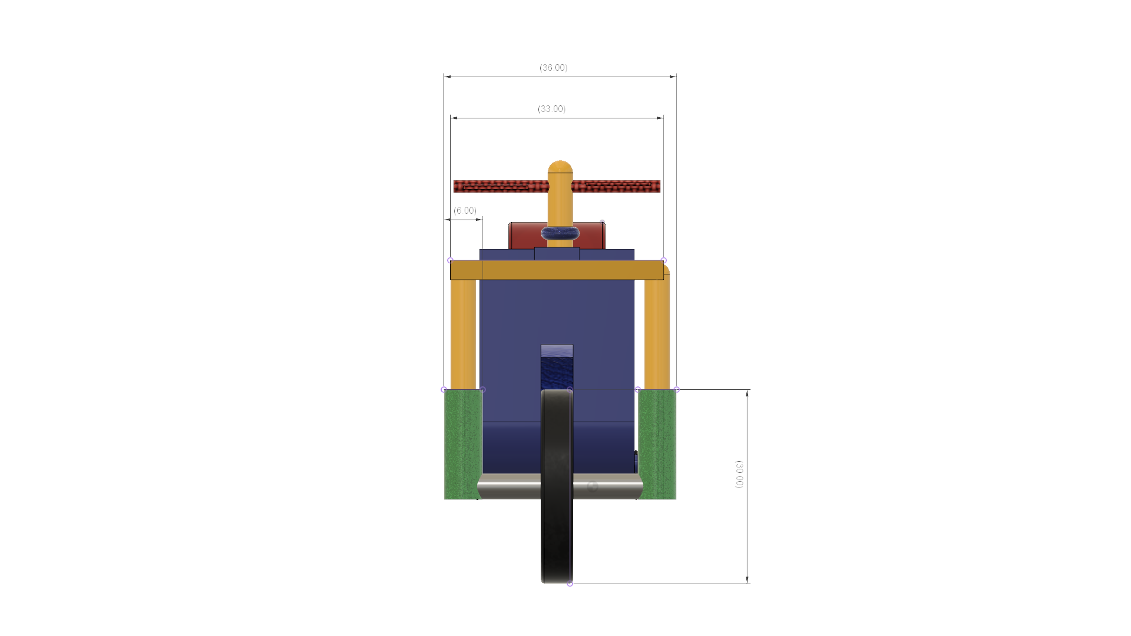
FRONT VIEW
All dimensions are in mm

Slide 9
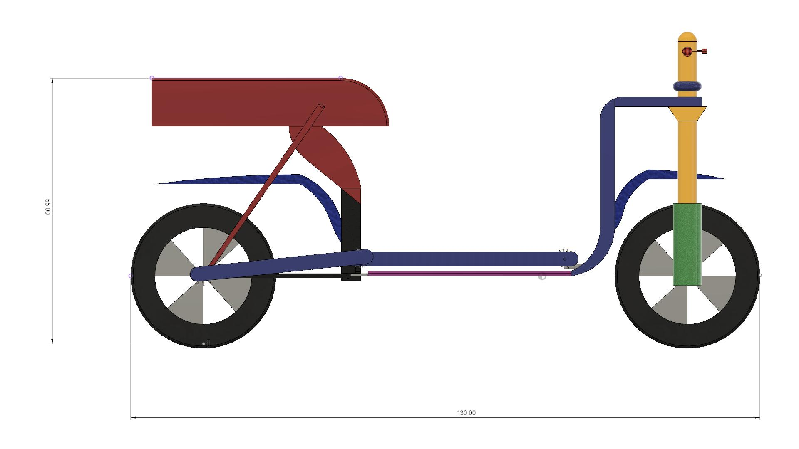
SIDE VIEW
All dimensions are in mm

Slide 10
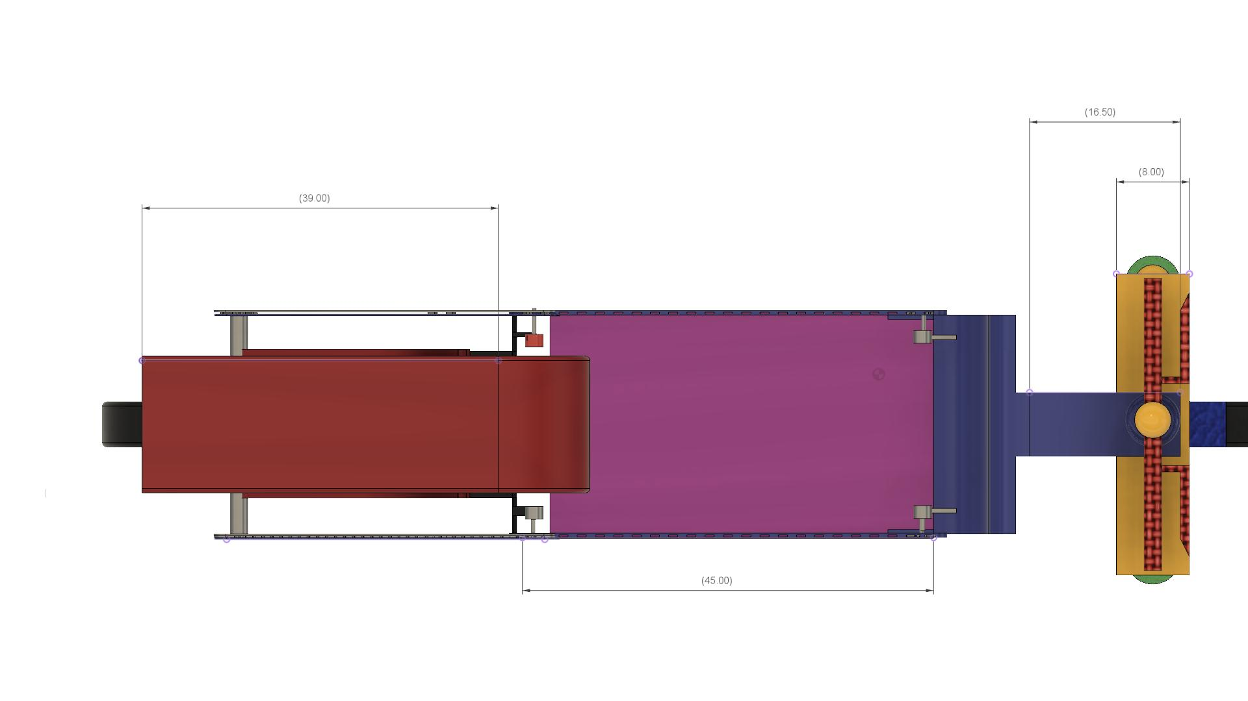
TOP VIEW

Slide 11
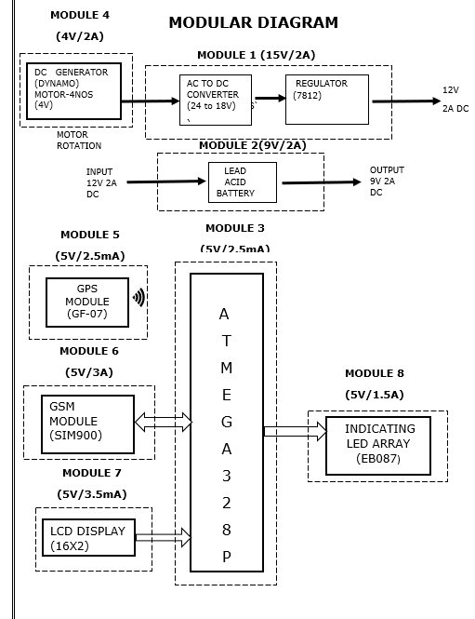
BLOCK DIAGRAM

Slide 12
MODULES
There are 8 modules:
Charging Circuit.
Battery 9V 2A.
ATMEGA328P Microcontroller.
Dynamo DC Generator.
GPS MODULE.
GSM MODULE.
LCD DISPLAY.
Indicating LED’S Array.

Slide 13
MODULE 1
CHARGING CIRCUIT(12VDC/2A)
We are using AC to DC Converter.
Regulator(7812) will regulate the voltage to 12V.
MOTOR ROTATION
AC TO DC CONVERTER (24 TO 18V)
12V REGULATOR (7812)
12V
2A DC

Slide 14
BILL OF MATERIALS
MODULE 1: CHARGING CIRCUIT
SL.NO | ITEM DESCRIPTION | SYMBOL | QUANTITY | PRICE
1 | DC TO DC CONVERTER | C1 | 1 | 60
2 | 12V REGULATOR | R1 | 1 | 30

Slide 15
MODULE 2
BATTERY (9VDC/2A)
9VDC/2A supply is used for Atmega328p.
5VDC/1A supply is used for LCD Display, GSM module, Indicating LED’s Array.
INPUT12V DC
LEAD ACID BATTERY
OUTPUT9V DC

Slide 16
BILL OF MATERIALS
MODULE 2: POWER SUPPLY (9V/2A)
SL NO | ITEM DESCRIPTION | SPECIFICATION | SYMBOL | QUANTITY
1 | BATTERY | 9V 2A | B1 | 1

Slide 17
MODULE 3
ATMEGA328P MICROCONTROLLER.
We are using atmega328p microcontroller for controlling
The Lopifit.
NAME | SPECIFICATION
Program Memory Type | Flash
Program Memory Size (KB) | 14
CPU Speed (MIPS/DMIPS) | 5
SRAM (KB) | 2
Data EEPROM/HEF (bytes) | 1024
digital Communication Peripherals | 1-UART,1-SPI,1-I2C,1-MSSP
Pin Count | 14
Capture/Compare/PWM Peripheral | 2 Input Capture, 1 CCP
Timers | 3
ADC Input | 6 ch, 10-bit
Number of Comparators | 1
Temperature Range (°C) | -40 to 85
Operating Voltage Range (V) | 7 to 12

Slide 18
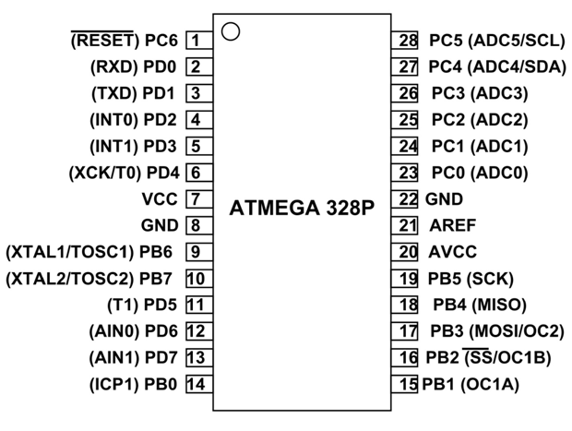
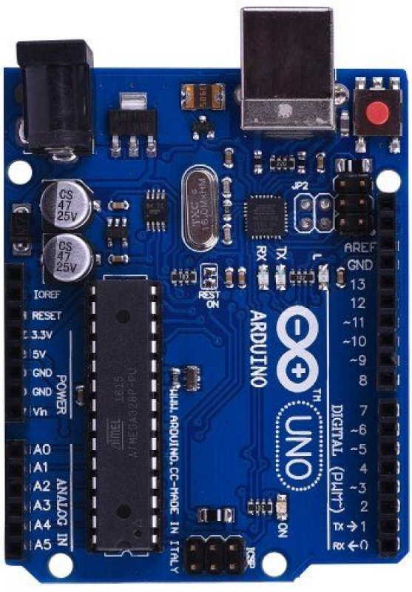
ATMEGA328P MICROCONTROLLER.

Slide 19
BILL OF MATERIALS
MODULE 3: MICROCONTROLLER ASSEMBLY
SL NO | ITEM DESCRIPTION | SYMBOL | QUANTITY(NO) | PRICE(INR)
1 | ATMEGA328P MICROCONTROLLER. | U1 | 1 | 350

Slide 20
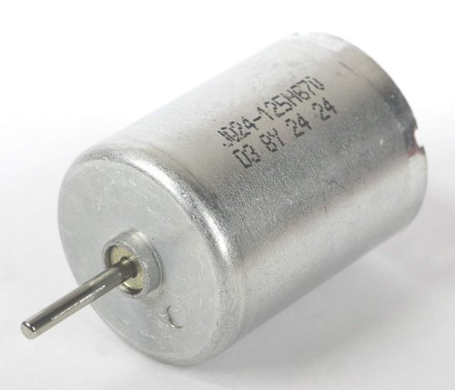
MODULE 4
DC GENERATOR
A dynamo is an electrical generator that creates direct current using a commutator. Dynamos were the first electrical generators capable of delivering power for industry, and the foundation upon which many other later electric-power conversion devices were based, including the electric motor, the alternating-current alternator, and the rotary converter.

Slide 21
BILL OF MATERIALS
MODULE 4:MOTOR DRIVER & MOTOR
SL NO | ITEM DESCRIPTION | SYMBOL | QUANTITY | PRICE
1 | DC GENERATOR | DG1,DG2,DG3 DG4 | 4 | 360

Slide 22
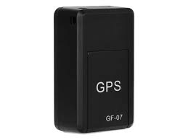
MODULE 5
GPS MODULE
GPS tracker you can track your car, bike, children etc. using a smartphone. it can also record sound or you can listen to real-time sound from surround it.

Slide 23
BILL OF MATERIALS
MODULE 5: GPS MODULE
SL NO | ITEM DESCRIPTION | SYMBOL | QUANTITY | PRICE
1 | GPS MODULE | G1 | 1 | 950

Slide 24
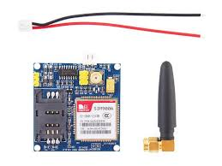
MODULE-6
GSM MODULE
A GSM module or a GPRS module is a chip or circuit that will be used to establish communication between a mobile device or a computing machine and a GSM or GPRS system.

Slide 25
BILL OF MATERIALS
MODULE 6: GSM MODULE
SL NO | ITEM DESCRIPTION | SYMBOL | QUANTITY | PRICE
1 | GSM MODULE | GS1 | 1 | 1000

Slide 26
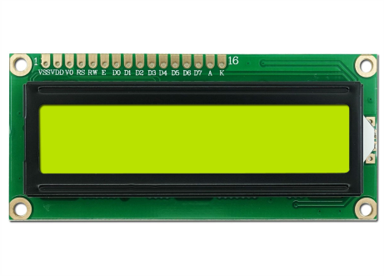
MODULE-7
LCD DISPLAY
LCD (Liquid Crystal Display) is a type of flat panel display which uses liquid crystals in its primary form of operation. LEDs have a large and varying set of use cases for consumers and businesses, as they can be commonly found in smartphones, televisions, computer monitors and instrument panels.

Slide 27
BILL OF MATERIALS
MODULE 7:LCD DISPLAY
SL NO | ITEM DESCRIPTION | SYMBOL | QUANTITY | PRICE
1 | LCD DISPLAY | L1 | 1 | 150

Slide 28
MODULE-8
INDICATING LED’S ARRAY
The LED Array board allows the exploration of basic display control mechanisms. The board features an 8 by 5 LED matrix where each LED has its own buffer to maintain the state. Each LED buffer output is connected to the input of the next meaning that data cascades from one LED to the next starting from LED D0 and running through to LED D40. Multiple LED Array boards can be connected together to form a longer LED chain
Fitting the boards to a 20mm pitch E-blocks backplane allows a constant spaced message board type display to be created.

Slide 29
BILL OF MATERIALS
MODULE 8:INDICATING LED’S ARRAY
SL NO | ITEM DESCRIPTION | SYMBOL | QUANTITY | PRICE
1 | INDICATING LED’S ARRAY | L1 | 3 | 150

Slide 30
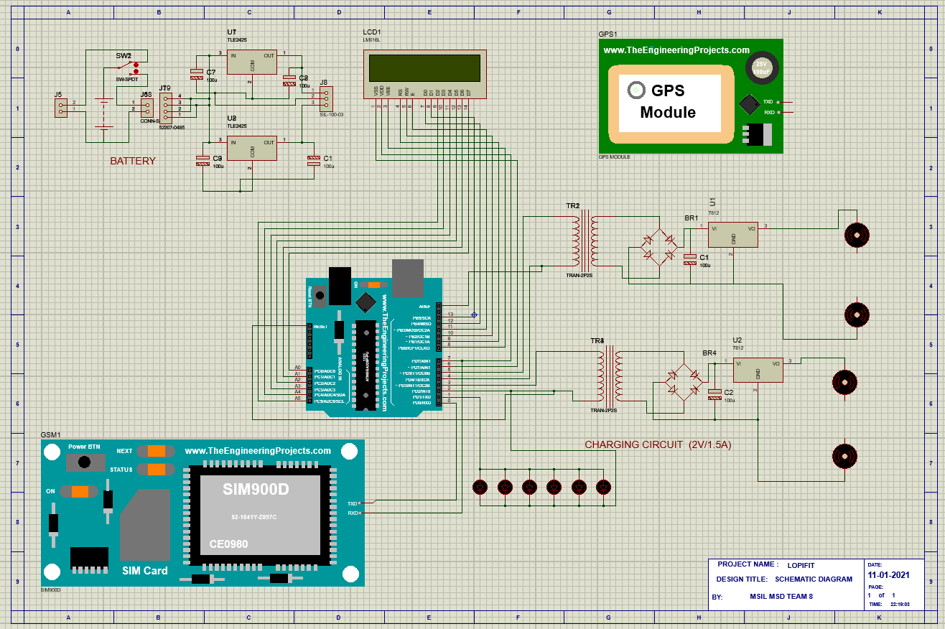
SCHEMATIC DIAGRAM

Slide 31
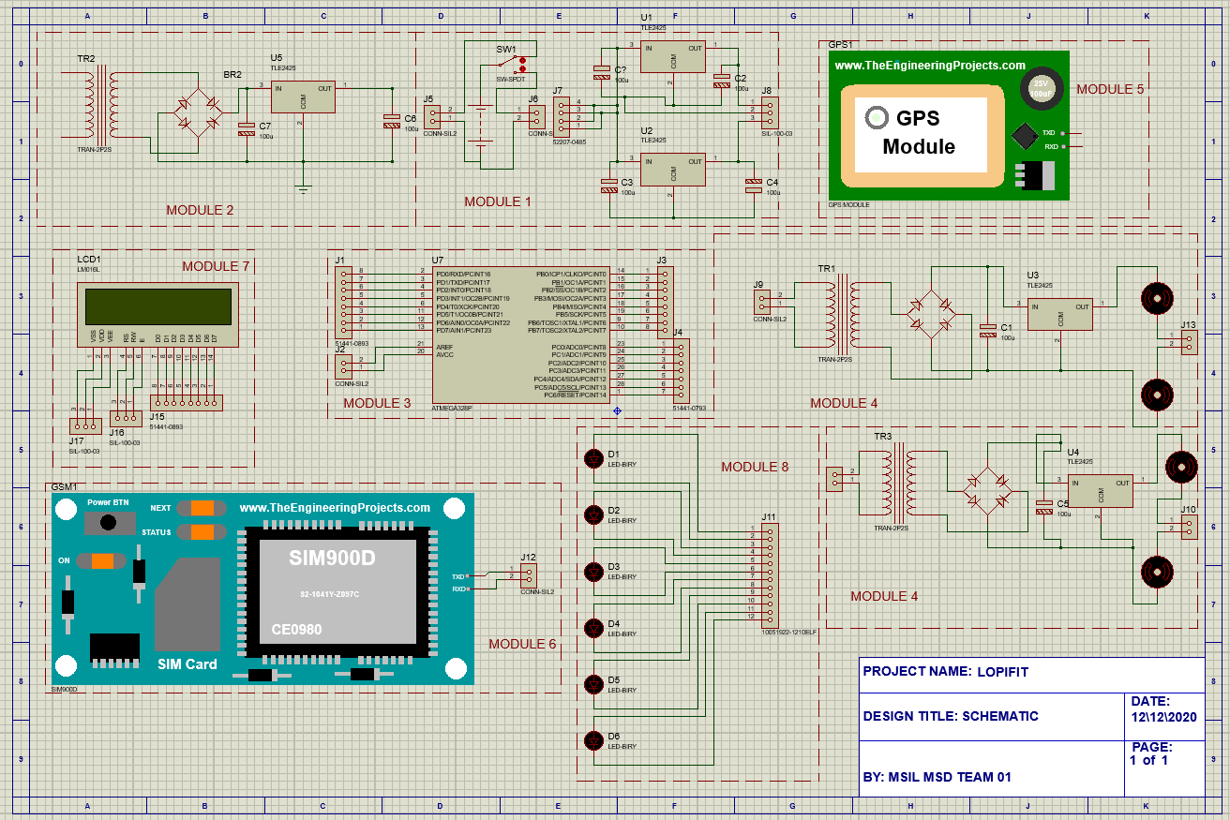
MODULEWISE SCHEMATIC DIAGRAM

Slide 32
APPLICATIONS
Can be used as domestic purpose vehicles.
Can be used in Corporate Offices for the internal transportation.
Can be used in Educational intuitions.

Slide 33
OVERALL BILL OF MATERIAL
MODULAR COMPONENTS
SL NO | MODULES | SPECIFICATION | QUANTITY (NO'S) | PRICE (INR)
1 | MODULE1: Battery | 7.5AH | 1 | 830
2 | MODULE2: Charging circuit (15v/1a) | CC | 1 | 635
3 | MODULE3: Arduino mega2560 (5v/1.5A) | ATMEGA328P | 1 | 450
4 | MODULE 4: GPS MODULE(GF-07) | GF-07 | 1 | 900
5 | MODULE 5 :DC GENERATOR | 4V | 4 | 360
6 | MODULE6: GSM MODULE(SIM900) | SIM900 | 1 | 900
7 | MODULE7: LED DISPLAY3(P10) | 32X16 | 1 | 500
8 | MODULE8:LED’S | 3V DC | 1 | 50
9 | Tool Kit | _ | 1 | AVAILABLE
TOTAL |  |  |  | 4625/-

Slide 34
MECHANICAL COMPONENTS
SL NO | COMPONENTS | SPECIFICATIONS | MATERIAL | QUANTITY (NO'S) | PRICE (INR)
1 | Frame | 12X4 INCH | M.S | 1 | 900
2 | Wheels | 20” (BACK) 24” (FRONT) | Rubber | 2 | 1200
3 | Treadmill Belt | V BELT | Rubber | 1 | 900
4 | Roller | 12 INCHES | M.S | 2 | 1000
7 | Sprocket | 15 INCHES | Steel | 2 | 550
8 | Chain | 52 INCHES | Steel | 1 | 560
10 | Bearing with Bearing Cap | 12 mm | M.S | 6 | 500
11 | Spur Gear | 10 to 200 mm | C.I | 2 | 650
 |  |  |  | TOTAL | 6260/-
TYPE | PRICE (INR)
MODULAR | 4525/-
MECHANICAL | 6260/-
TOTAL | 10885/-

Slide 35
CONCLUSION
This project (Lopifit) can be efficiently used anywhere whether it is outdoor or indoor. This utilizes highly fuel-saving technology which is a major requirement of this era. In the future, it can be used as an indoor locomotive device infrastructure with large roof span i.e. malls, warehouse, open markets, large office spaces, etc. By using such product pedestrian cops can protect themselves from getting exhausted. Pedestrians in large campuses can take benefit from this product the same way.

